Slide 1
Amazon Data Analysis
Faisal
Cohort = 12
Data Analytics

Slide 2


Slide 3
Table of contents
About Data Set
ERD
DATA DICTIONARY
Question & Answers
Recommendations
Review

Slide 4
About Data Set
This dataset is having the data of 1K+ Amazon Product's Ratings and Reviews as per their details listed on the official website of Amazon. The primary goal of this project is to analyse the Amazon Sales dataset and identify insights based on the data. The Amazon Sales dataset is a valuable resource for businesses and researchers alike. It provides a wealth of information about customer behaviour, product trends, and market conditions. By conducting exploratory data analysis (EDA) on this dataset, businesses can gain valuable insights that can help them make better decisions about their products, marketing, and operations.

Slide 5
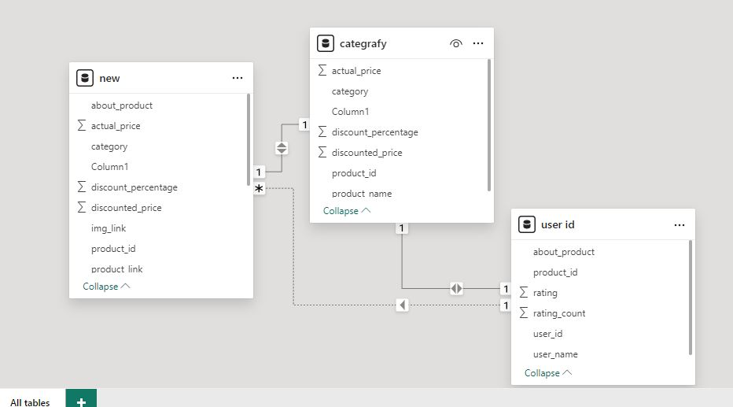
ERD Diagram

Slide 6
Data Dictionary
S NO | Columns | Data Types | Columns Details
1 | product_id | object | Product ID
2 | ProductName | object | Name of the Product
3 | category | object | Category of the Product
4 | discounted price | float64 | Discounted Price of the Product
5 | actual price | float64 | Actual Price of the Product
6 | discount percentage | float64 | Percentage of Discount for the Product
7 | rating | float64 | Rating of the Product
8 | rating count | float65 | Number of people who voted for the Amazon rating
9 | about product | object | Description about the Product
10 | user_id | object | ID of the user who wrote review for the Product
11 | user_name | object | Name of the user who wrote review for the Product
12 | review_id | object | User Review ID
13 | review title | object | Short review
14 | review content | object | Long review
15 | image_link | object | Image Link of the Products
16 | product_link | object | Official Website Link of the Product

Slide 7
Questions And Answers

Slide 8
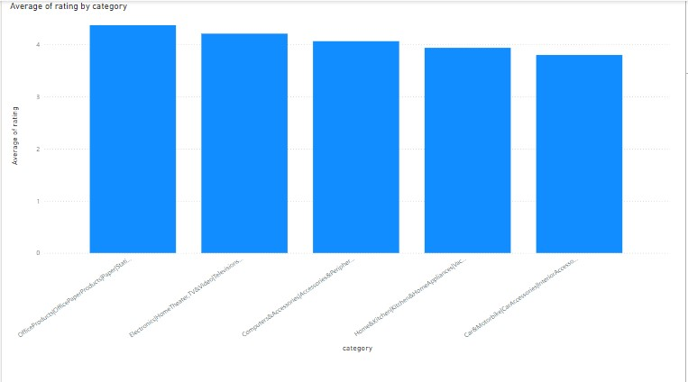
Q1: What is the average rating for each product category?
Overall Positive Feedback: Most categories are rated above 3.50, indicating satisfactory customer experiences.

Slide 9
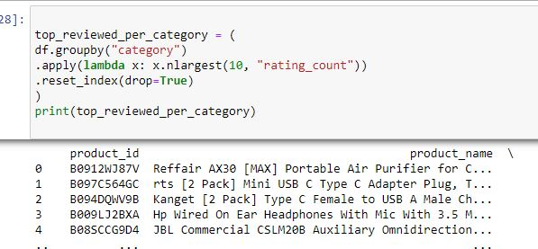
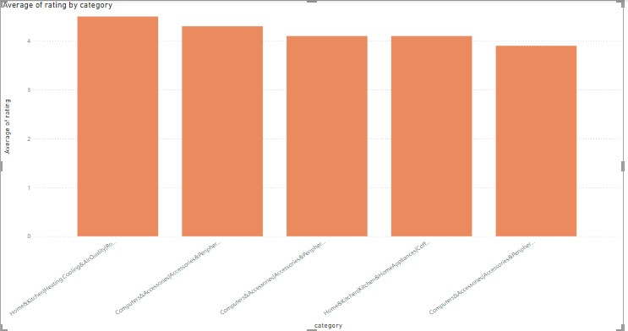
Q2: What are the top rating count products by category?
The review counts for products range from 9 to 15,867, indicating varying levels of attention and feedback across different products.

Slide 10
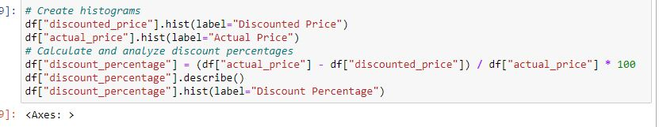
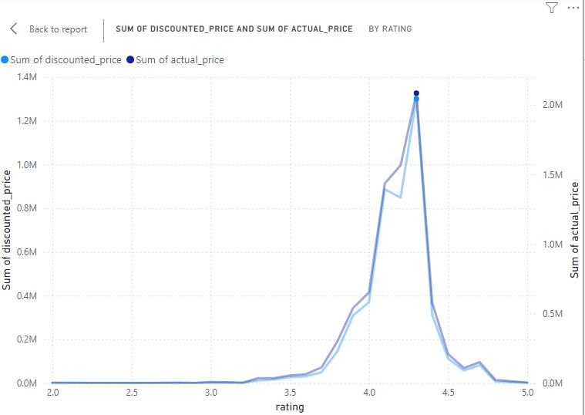
Q3: What is the distribution of discounted prices vs actual prices?
The output indicates that discounted prices are generally lower than actual prices, with a median discounted price

Slide 11
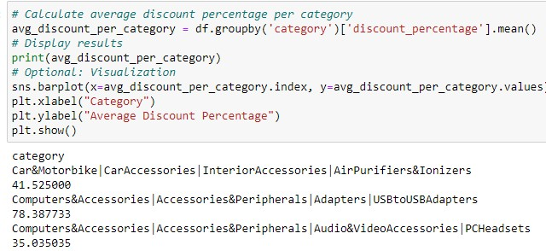
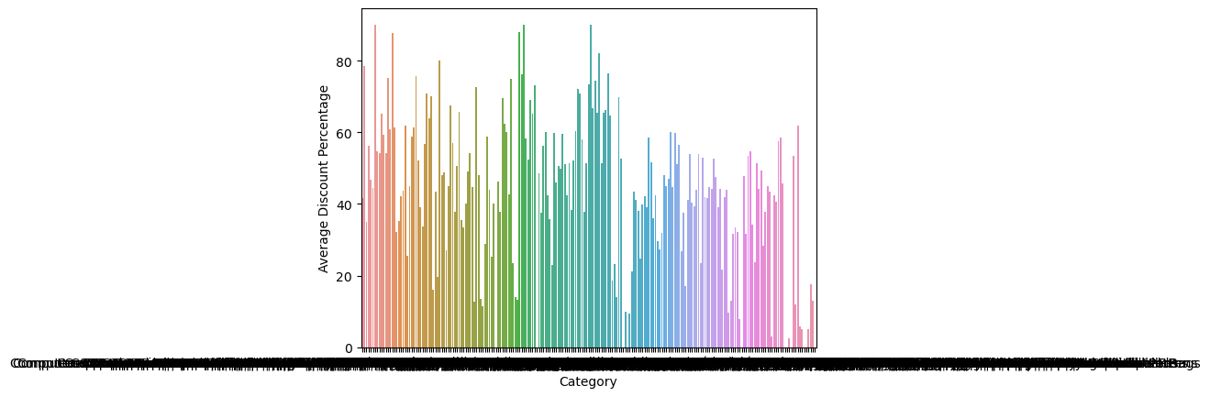
Q4: How does the average discount percentage vary across categories?
Analysis of Average Discount Percentages The average discount percentages vary widely across categories, ranging from 0% to 78.39%.
Key Insights: High Average Discounts:
Category 1: 78.39% Category 3: 56.34% These high averages may indicate factors such as clearance efforts, high competition, or lower profit margins. Zero Average Discounts:
Categories 0, 206, 207, 210: 0% This suggests consistent pricing or strong demand for products within these categories. Varying Discounts: Other categories exhibit a range of discount percentages, reflecting diverse pricing strategies and market dynamics.

Slide 12

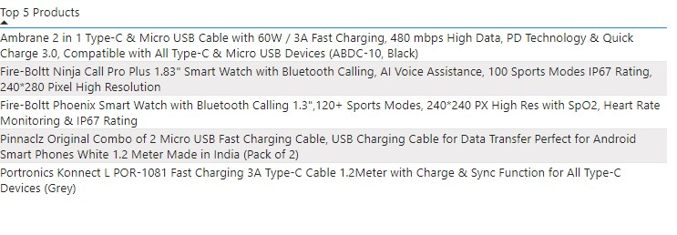
Q5: What are the most popular product name?
Beyond the leading products, popularity is relatively evenly distributed across other products.

Slide 13

Q6: What is the correlation between discounted price and rating?
Discounted price and rating have a weak positive correlation. This indicates that products with higher discounted prices tend to have slightly higher ratings. However, the relationship between discounted price and rating is not very strong.
Correlation between discounted price and rating: 0.12

Slide 14
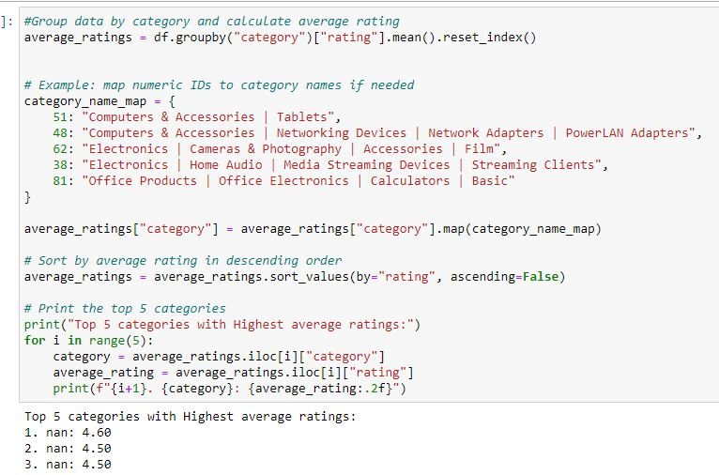
Q7: What are the Top 5 categories based with highest ratings?
categories share a rating of 4.50, suggesting similar levels of customer satisfaction across these areas.

Slide 15
Recommendations
Continue promoting the top products to leverage their popularity.
Consider increasing discounted prices or discount percentages to attract more customers.
Evaluate current discount strategies and explore adjustments that could enhance customer appeal and drive sales
Examine the reasons behind higher average discounts in certain categories to optimize pricing and profitability.
Explore and implement strategies to address the issues identified in lower rated categories

Slide 16
Thank You

